Slide 1
Criminal justice management system proposal

Slide 2
AGENDA
Overview
Project objectives
UML
Timeline
Queries

Slide 3
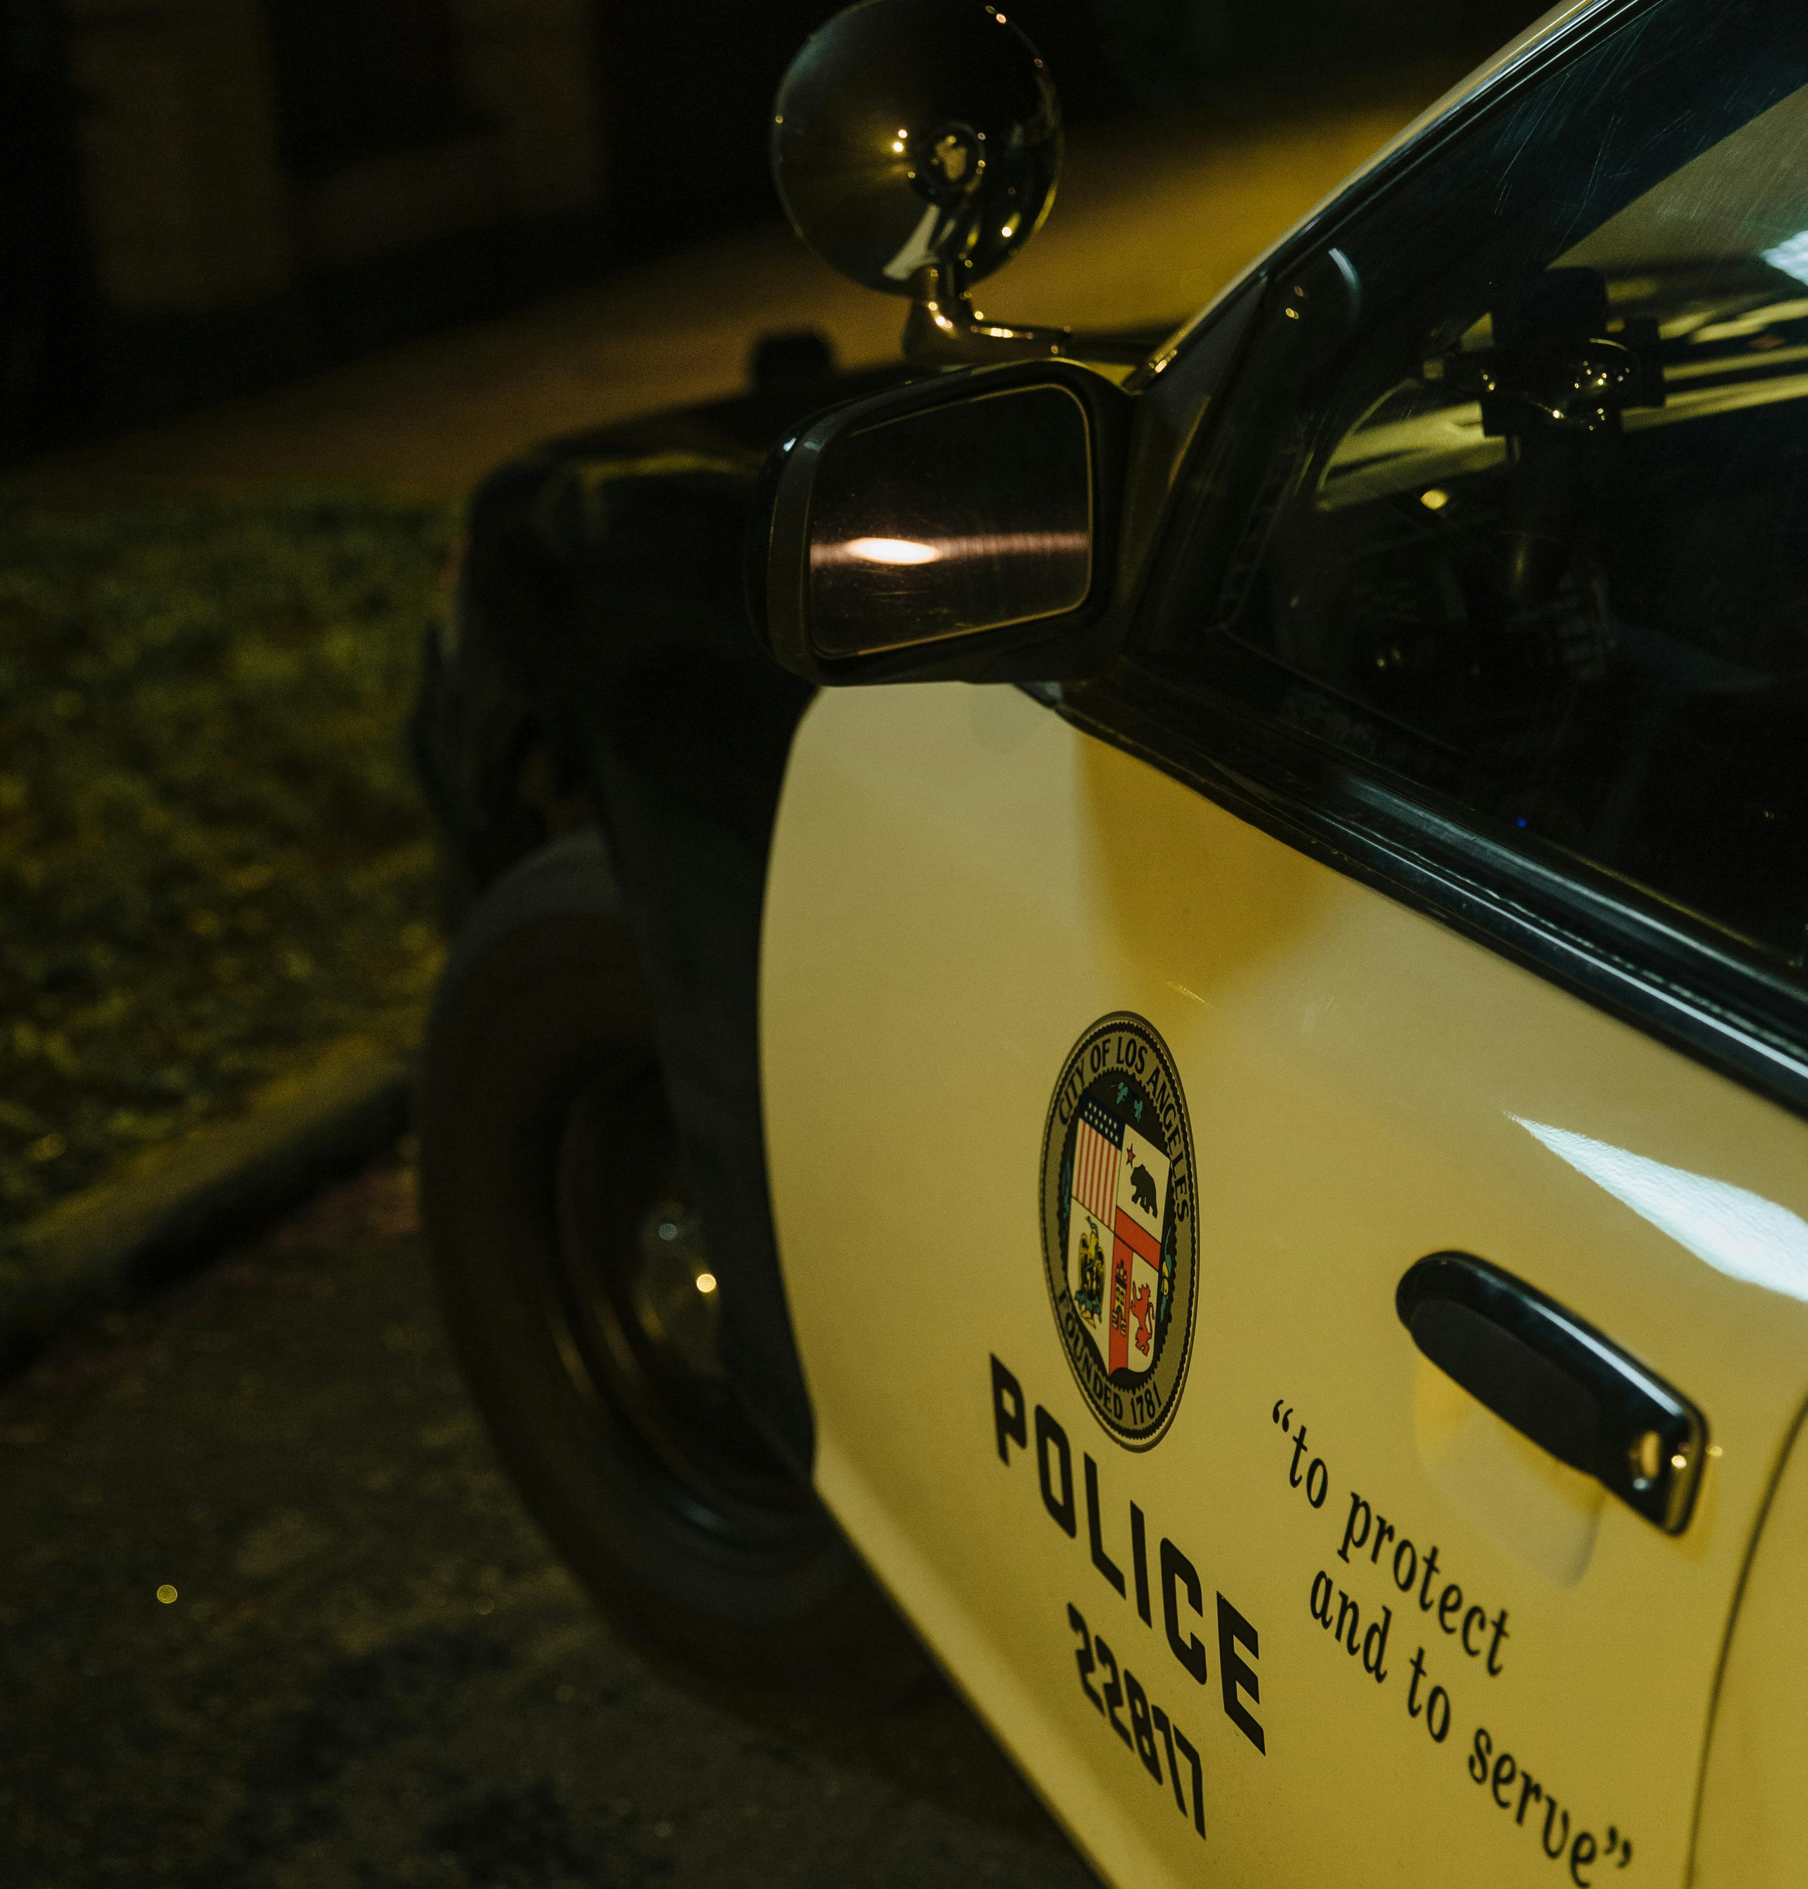
Overview

Slide 4
A Criminal Justice Management System is essential for:
Efficient Resource Allocation:
Centralizes data for optimal deployment of personnel and equipment, minimizing response times.
Crime Prevention:
Analyzes data to identify crime trends, enabling proactive interventions to reduce crime rates.
Community Safety:
Builds trust and engagement, encouraging citizen participation in crime prevention efforts.

Slide 5
project Objectives:
Enhancing Public Safety:
Implementing a comprehensive Police Management System to facilitate swift and effective responses to public safety concerns.
Enhancing emergency response capabilities and ensuring timely assistance to individuals in distress.
Improving Crime Prevention Strategies:
Leveraging data analytics and predictive modeling to identify crime hotspots and emerging trends.
Developing proactive policing strategies tailored to specific community needs and crime patterns.

Slide 6
Optimizing Resource Allocation:
Streamlining resource allocation processes to ensure the efficient deployment of personnel, vehicles, and equipment.
Utilizing real-time data insights to prioritize areas with the highest crime rates and allocate resources accordingly.
Strengthening Community Relations:
Establishing open communication channels between law enforcement agencies and the community.
Implementing community engagement initiatives to build trust, foster collaboration, and address community concerns effectively.

Slide 7
uml

Slide 8
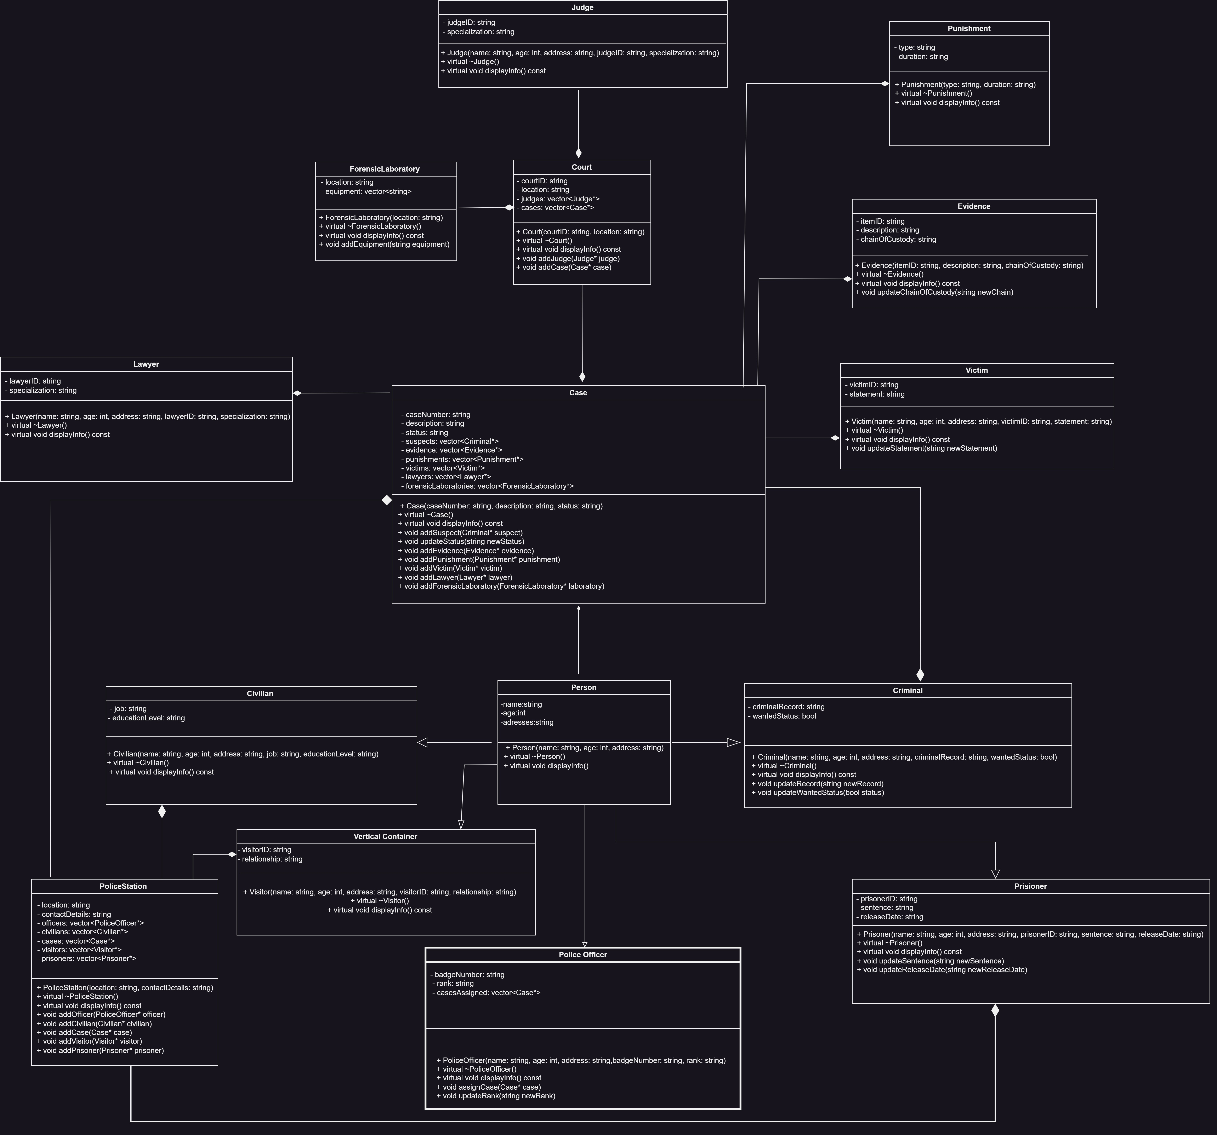
Uml

Slide 9
Timeline
Development: (3-4)-weeks
Testing:(1-2)-week
Estimated completion:6-weeks

Slide 10
Q&A
Any question or queries?

Slide 11
THANK YOU
Muhammad Moiz Ahmad
BSCE-22029
Shawaiz Asghar
BSCE-22036
Aliyan Waseem
BSCE-23004

